Slide 1
MY TRAVEL DIARY
19Z612 APPLICATION DEVELOPMENT LABORATORY
VEDAVARSHINI A
21Z368

Slide 2
EXERCISE 1:
The following concepts were included in the website
Basic of HTML
Tags
Document Tags
Grouping Tags
Head Tags
Body Tags
Text-level Flow Tags
Ordered Lists
Unordered Lists
Definition Lists
Table Tags
Table borders
Attributes
CREATING A SIMPLE WEBPAGE USING HTML

Slide 3
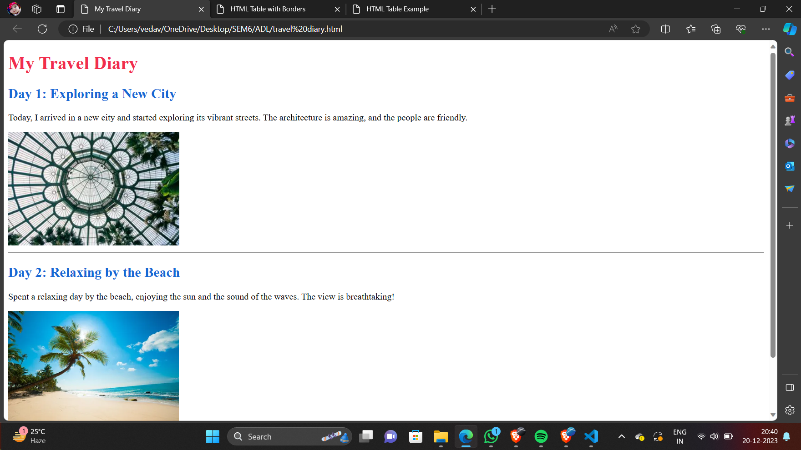
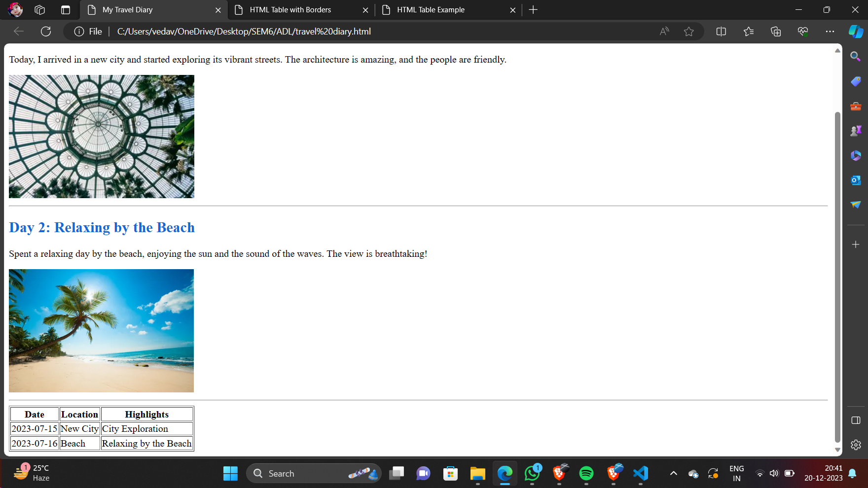
SCREENSHOT:

Slide 4
EXERCISE 2:
1. Images: Use <img> tag with src, alt, width, and height attributes for image embedding.
2. Hyperlinks: Employ <a> tag with href attribute for creating navigation links.
3. Forms: Utilize <form> tag with various input elements and action, method attributes for interactive data collection.
4. Videos: Embed <video> tag with src, controls, autoplay, loop attributes for video integration.
5. Enhanced Interactivity: Integrating multimedia elements enhances user engagement and interaction in HTML documents.
ADDING OF IMAGES, HYPERLINKS, FORMS AND VIDEOS

Slide 5
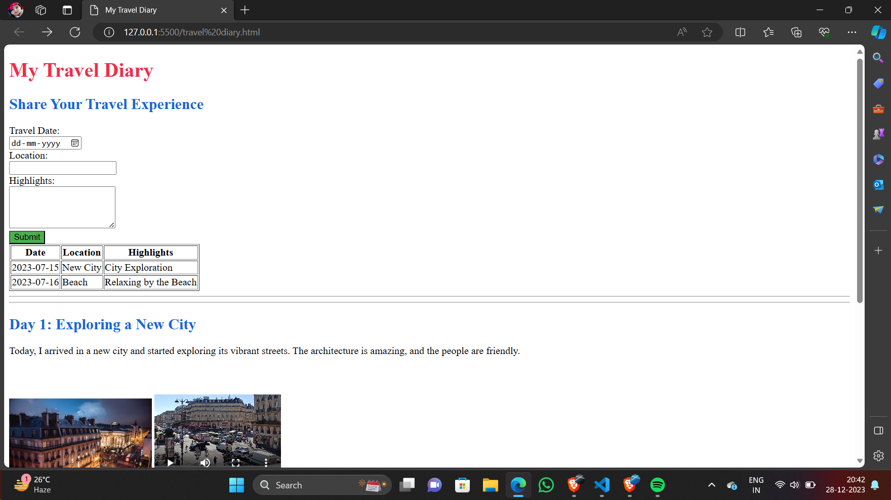
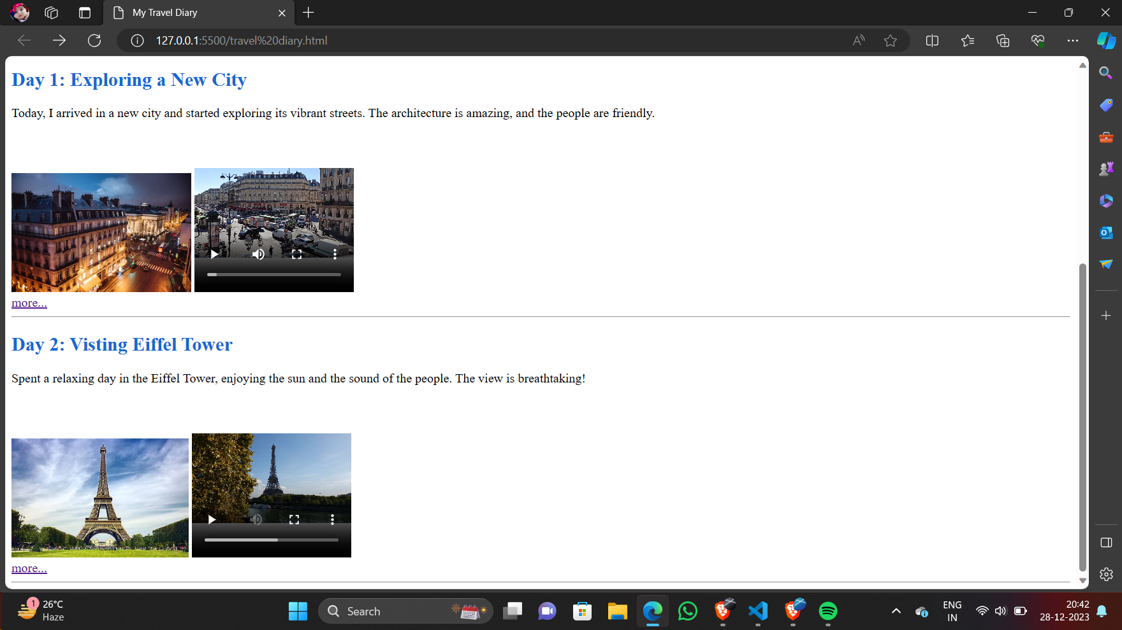
SCREENSHOT:

Slide 6
EXERCISE 3:
The following concepts were included in the website
Comments
Backgrounds
Borders
Margins
Padding
Height, Width
Box Model
Outline
Text and font
Icons
Links
Lists
Tables
Navigation bar
Dropdown
Image Gallery
Image Sprites
Attribute Selectors
Forms
Counters
CASCADING STYLE SHEET

Slide 7
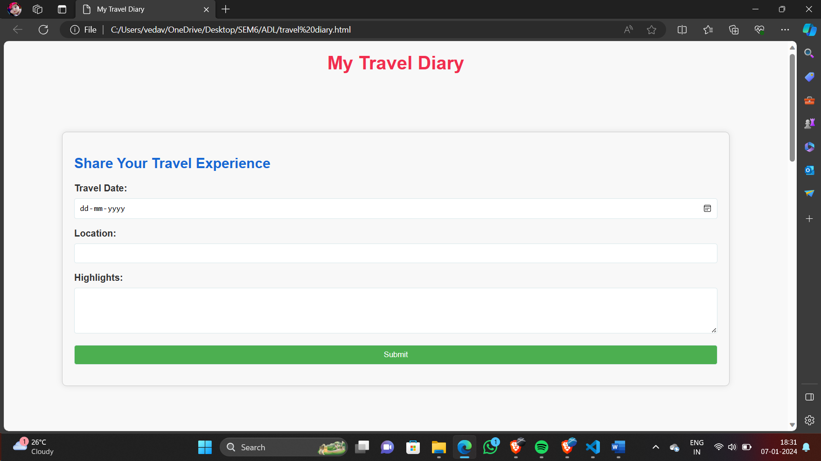
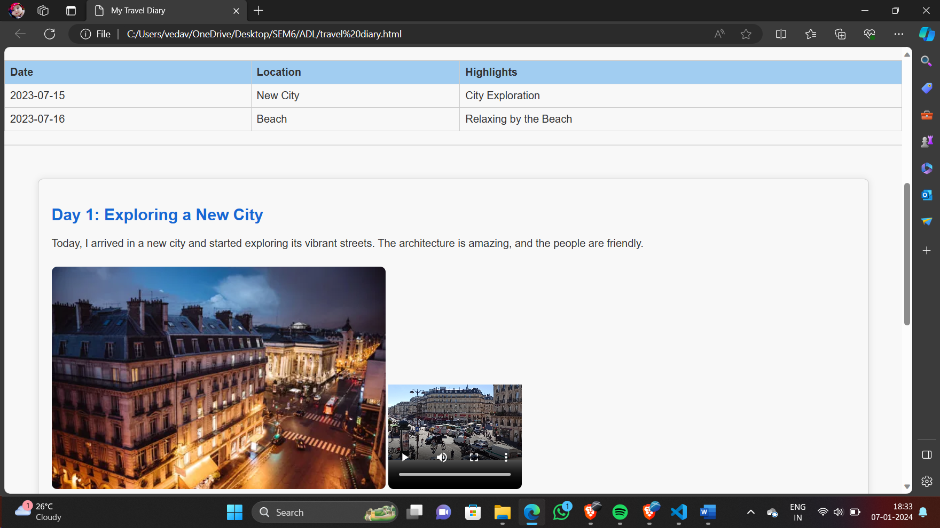
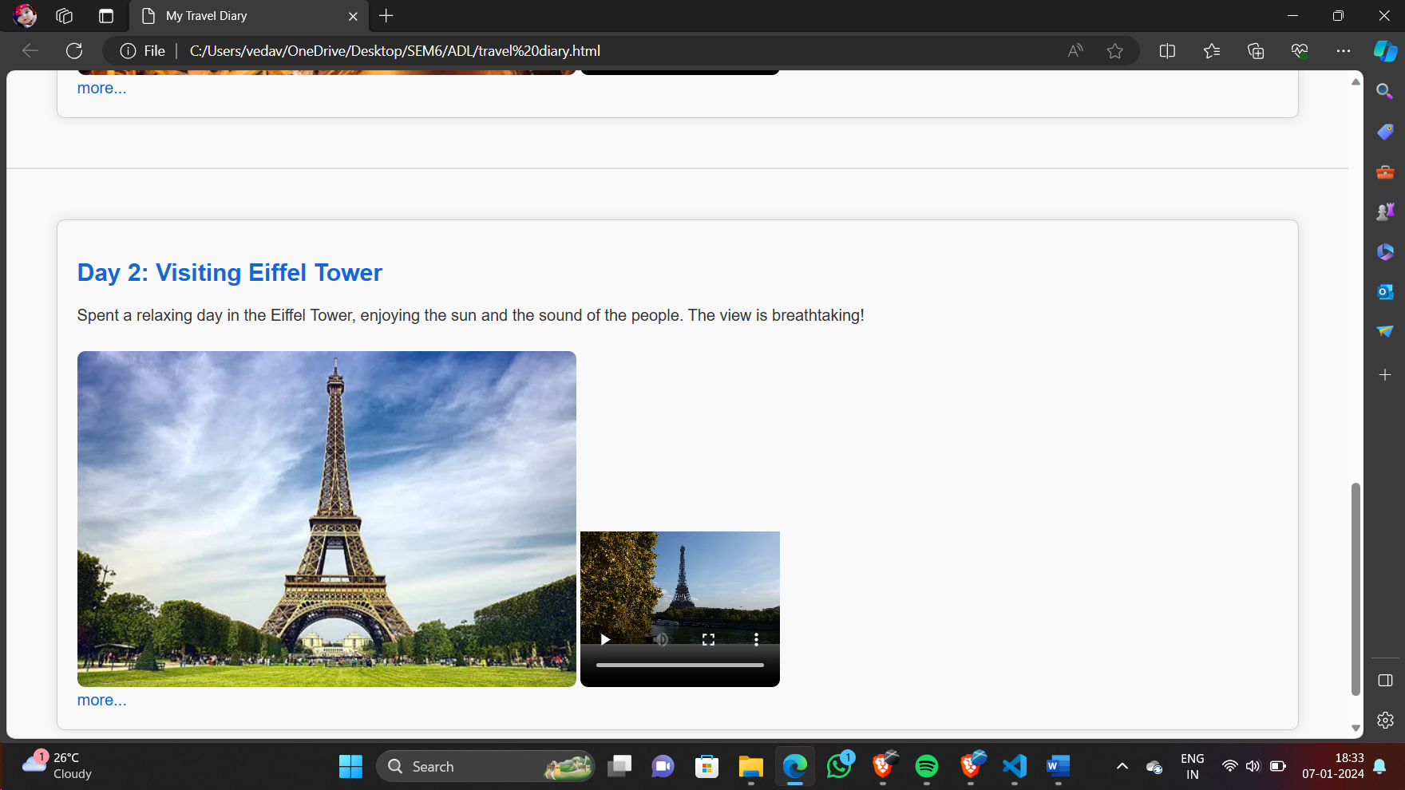
SCREENSHOT:

Slide 8
EXERCISE 4:
Designing a dynamic web page with validation using JavaScript involves creating a webpage that responds to user input and validates it before submission.
JavaScript is used to add interactivity, manipulate the DOM (Document Object Model), and validate form inputs in real-time.
This exercise helps in understanding client-side scripting, event handling, and form validation techniques to enhance user experience and ensure data integrity.
DESIGNING A DYNAMIC WEBPAGE WITH VALIDATION
USING JAVASCRIPT

Slide 9
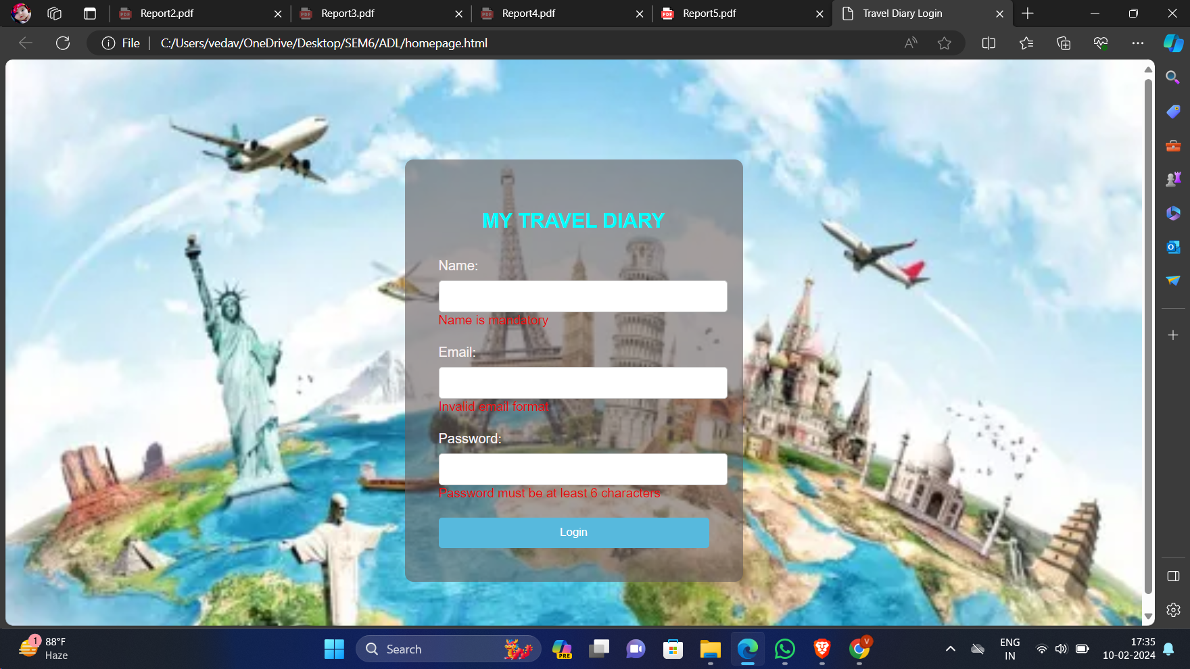
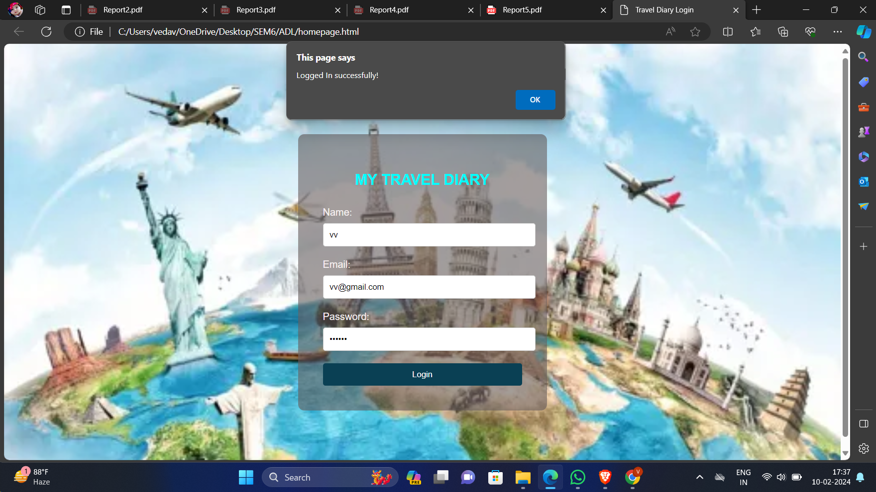
SCREENSHOT:

Slide 10
EXERCISE 5:
Designing a simple web application using Servlets involves creating dynamic web pages that can handle user requests and generate responses dynamically on the server-side.
Servlets are Java classes that extend the functionality of web servers to process requests, interact with databases, and generate dynamic content.
This exercise helps in understanding the fundamentals of Java web development, including request handling, session management, database connectivity, and MVC (Model-View-Controller) architecture.
Through Servlets, developers can build scalable and robust web applications that can handle user interactions effectively.
DESIGNING A SIMPLE WEB APPLICATION USING SERVLETS

Slide 11
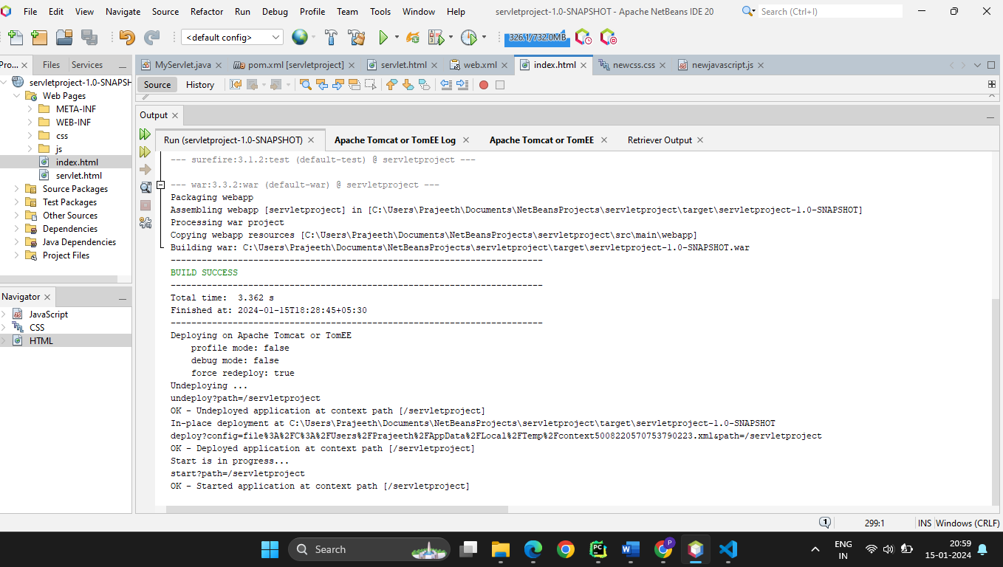
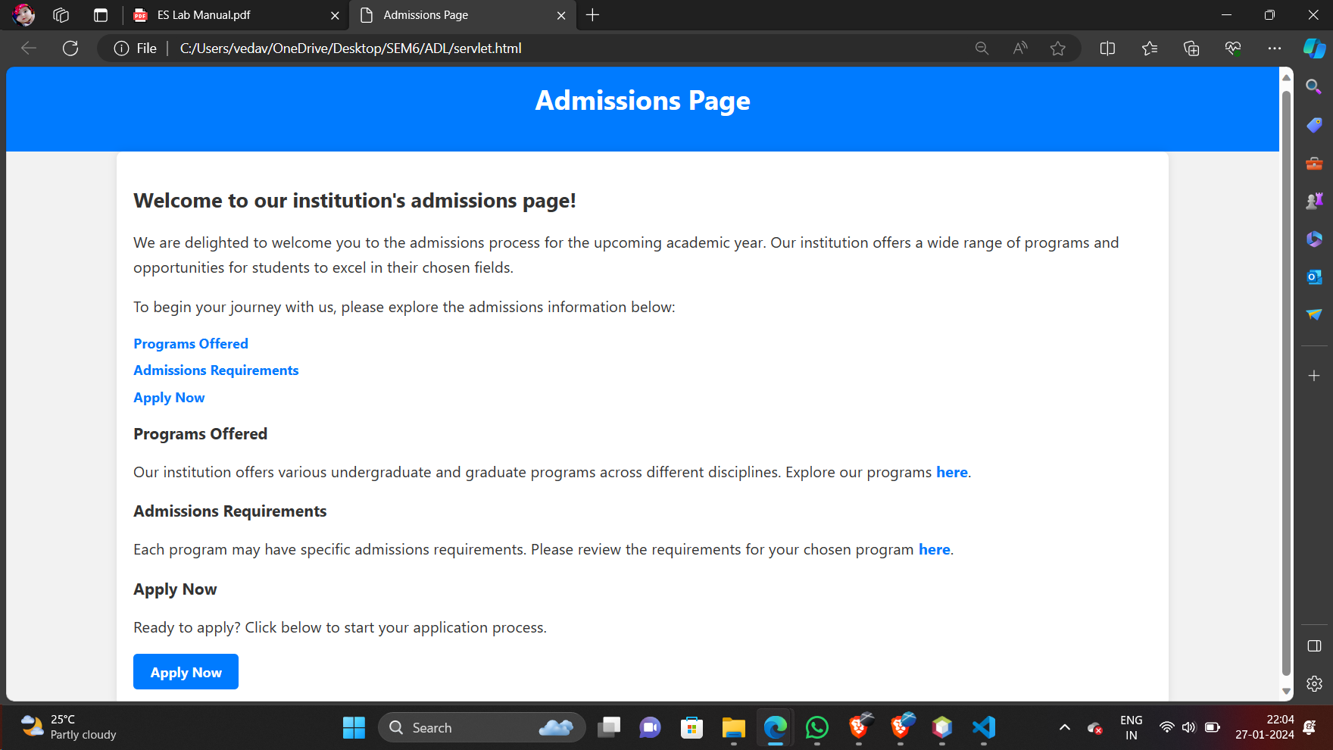
SCREENSHOT:

